Slide 1

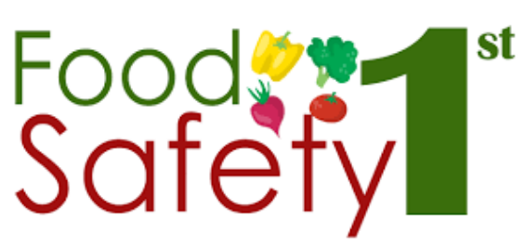
Food adulteration acts PART III
Mary Anupama Palukurty
Assistant Professor,
Dept. of Biochemistry,
St.Joseph’s College for Women (A),
Visakhapatnam

Slide 2
The Food and Drug Administration (FDA or USFDA)
The Food and Drug Administration (FDA or USFDA) is a federal agency of the United States Department of Health and Human Services, one of the United States federal executive departments.
The FDA is responsible for protecting and promoting public health through the control and supervision of food safety, tobacco products, dietary supplements, prescription and over-the-counter pharmaceutical drugs (medications), vaccines, biopharmaceuticals, blood transfusions, medical devices, electromagnetic radiation, vaccines, biopharmaceuticals, blood transfusions, medical devices, electromagnetic radiation emitting devices (ERED), cosmetics, animal foods & feed and veterinary products.

Slide 3
The FDA was empowered by the United States Congress to enforce the Federal Food, Drug, and Cosmetic Act, which serves as the primary focus for the Agency; the FDA also enforces other laws, notably Section 361 of the Public Health Service Act and associated regulations, many of which are not directly related to food or drugs.
These include regulating lasers, cellular phones, condoms and control of disease on products ranging from certain household pets to sperm donation for assisted reproduction.
The FDA is led by the Commissioner of Food and Drugs, appointed by the President with the advice and consent of the Senate.
The Commissioner reports to the Secretary of Health and Human Services. Admiral Brett P. Giroir is the acting commissioner, as of November 2019.

Slide 4
CODEX ALIMENTARIUS
It is a collection of internationally recognized standards, codes of practice, guidelines, and other recommendations relating to foods, food production, and food safety.
Its name is derived from the Codex Alimentarius Austriacus.
Its texts are developed and maintained by the Codex Alimentarius Commission, a body that was established in early November 1961 by the Food and Agriculture Organization of the United Nations (FAO), was joined by the World Health Organization (WHO) in June 1962.
The Commission's main goals are:
to protect the health of consumers and
ensure fair practices in the international food trade.

Slide 5
The Codex Alimentarius is recognized by the World Trade Organization as an international reference point for the resolution of disputes concerning food safety and consumer protection.
As of 2012, there were 186 members of the Codex Alimentarius Commission: 186 member countries and one member organization, the European Union (EU). There were 215 Codex observers: 49 intergovernmental organizations, 150 non-governmental organizations, and 16 United Nations organizations.

Slide 6
SCOPE
The Codex Alimentarius covers all foods, whether processed, semi-processed or raw.
In addition to standards for specific foods, the Codex Alimentarius contains general standards covering matters such as food labeling, food hygiene, food additives and pesticide residues, and procedures for assessing the safety of foods derived from modern biotechnology.
It also contains guidelines for the management of official i.e. governmental import and export inspection and certification systems for foods.
The Codex Alimentarius is published in the six official languages of the United Nations: Arabic, Chinese, English, French, Spanish and Russian.

Slide 7
General texts
Food labelling (general standard, guidelines on nutrition labelling, guidelines on labelling claims).
Food additives (general standard including authorized uses, specifications for food grade chemicals)
Contaminants in foods (general standard, tolerances for specific contaminants including radionuclides, aflatoxins and other mycotoxins.
Pesticide and veterinary chemical residues in foods (maximum residue limits)
Risk assessment procedures for determining the safety of foods derived from biotechnology (DNA-modified plants, DNA-modified micro-organisms, allergens)
Food hygiene (general principles, codes of hygienic practice in specific industries or food handling establishments, guidelines for the use of the Hazard Analysis and Critical Control Point or “HACCP” system)
Methods of analysis and sampling

Slide 8
Specific standards
Meat products (fresh, frozen, processed meats and poultry)
Fish and fishery products (marine, fresh water and aquaculture)
Milk and milk products
Foods for special dietary uses (including infant formula and baby foods).
Fresh and processed vegetables, fruits, and fruit juices
Cereals and derived products, dried legumes
Fats, oils and derived products such as margarine
Miscellaneous food products (chocolate, sugar, honey, mineral water)

Slide 9
THE WTO AGREEMENT ON THE APPLICATION OF SANITARY AND PHYTOSANITARY MEASURES (SPS AGREEMENT)
The Agreement on the Application of Sanitary and Phytosanitary Measures sets out the basic rules for food safety and animal and plant health standards.
It allows countries to set their own standards.
But they should not arbitrarily or unjustifiably discriminate between countries where identical or similar conditions prevail.
Member countries are encouraged to use international standards, guidelines and recommendations where they exist
They can also set higher standards based on appropriate assessment of risks

Slide 10
Key Features
All countries maintain measures to ensure that food is safe for consumers, and to prevent the spread of pests or diseases among animals and plants.
These sanitary and phytosanitary measures can take many forms, such as requiring products to come from a disease-free area, inspection of products, specific treatment or processing of products, setting of allowable maximum levels of pesticide residues or permitted use of only certain additives in food.
Sanitary (human and animal health) and phytosanitary (plant health) measures apply to domestically produced food or local animal and plant diseases, as well as to products coming from other countries.

Slide 11
Articles of WTO
Article 1 : General Provisions:
This Agreement applies to all sanitary and phytosanitary measures which may, directly or indirectly, affect international trade.
Article 2: Basic Rights and Obligations
Members have the right to take sanitary and phytosanitary measures necessary for the protection of human, animal or plant life or health, provided that such measures are not inconsistent with the provisions of this Agreement.
Article 3 : Harmonization
To harmonize sanitary and phytosanitary measures on as wide a basis as possible, Members shall base their sanitary or phytosanitary measures on international standards, guidelines or recommendations.
Article 4 : Equivalence
Members shall accept the sanitary or phytosanitary measures of other Members as equivalent, even if these measures differ from their own.

Slide 12
Article 5 : Assessment of Risk and Determination of the Appropriate Level of Sanitary or Phytosanitary Protection
Article 6 : Adaptation to Regional Conditions, Including Pest — or Disease — Free Areas and Areas of Low Pest or Disease Prevalence
Article 7 : Transparency
Members shall notify changes in their sanitary or phytosanitary measures and shall provide information on their sanitary or phytosanitary measures in accordance with the provisions of Annex B.

Slide 13
Article 8 : Control, Inspection and Approval Procedures
Members shall observe the provisions of Annex C in the operation of control, inspection and approval procedures for approving the use of additives or for establishing tolerances for contaminants in foods, beverages or feedstuffs
.
Article 9 : Technical Assistance
Members agree to facilitate the provision of technical assistance to other Members, especially developing country Members, either bilaterally or through the appropriate international organizations.
Article 10 : Special and Differential Treatment
In the preparation and application of sanitary or phytosanitary measures, Members shall take account of the special needs of developing country Members, and in particular of the least-developed country Members.
Article 11 : Consultations and Dispute Settlement
The provisions of Articles XXII and XXIII of GATT 1994 as elaborated and applied by the Dispute Settlement Understanding shall apply to consultations and the settlement of disputes under this Agreement, except as otherwise specifically provided herein

Slide 14
Article 12 : Administration
A Committee on Sanitary and Phytosanitary Measures is hereby established to provide a regular forum for consultations and carrying out functions
Article 13 : Implementation
Members are fully responsible under this Agreement for the observance of all obligations set forth herein
Article 14 : Final Provisions
The least-developed country Members may delay application of the provisions of this Agreement for a period of five years with respect to their sanitary or phytosanitary measures affecting importation or imported products.

Slide 15
TECHNICAL BARRIERS TO TRADE TBTs
TBTs is a category of nontariff barriers to trade, are the widely divergent measures that countries use for the following:
to regulate markets,
protect their consumers, or
preserve their natural
also can be used to discriminate against imports in order to protect domestic industries.

Slide 16
TBTs are classified and defined as "Measures referring to technical regulations, and procedures for assessment of conformity with technical regulations and standards, excluding measures covered by the SPS Agreement".
Here, technical barriers to trade refer to measures such as: labeling requirements, standards on technical specifications and quality standards, and other measures protecting the environment.

Slide 17
Other examples of TBTs are rules for:
product weight,
size, or
packaging;
ingredient or identity standards;
shelf-life restrictions; and
import testing and certification procedures.

Slide 18
Standards of identity for food
Standards of identity for food are mandatory requirements that are set by a governing body to determine what a food product must contain to be marketed under a certain name in allowable commerce.
Mandatory standards, which differ from voluntary grades and standards are applied to:
agricultural commodities,
protect the consumer by ensuring a label accurately
Label has to reflect what is inside (for example, that mayonnaise is not an imitation spread or that ice cream is not a similar but different frozen dessert).

Slide 19
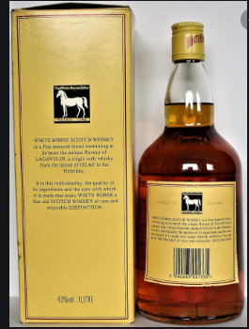
A US trade organization defines the term as follows:
"A standard of identity sets out what ingredients a product must contain, which ingredients it may contain, and any requirements of manufacturing.”
For example, “Whisky” is defined as “a potable alcoholic distillate obtained from a mash of cereal grain saccharified by diastase of malt or by other enzymes and fermented by the action of yeast”.
It may contain caramel and flavouring. No other ingredients are allowed.

Slide 20
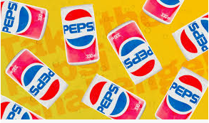
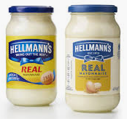
If someone were to produce a whisky containing a dye, they would not be permitted to call the product “whisky”, since dye is not a permitted additive.
Standards of identity are set out in the Food and Drug Regulations. They may be identified by the symbol “[S]” following the product name in boldface type.
As such, they are official common names for products and no other name can be substituted."
A 2014 lawsuit in the United States illustrated the necessity of such regulations. When Hampton Creek implied in its advertising that mayonnaise being marketed by Unilever was not "real" mayonnaise, the latter sued Hampton for defamation and cited the definitions promulgated by the Food and Drug Administration

Slide 21
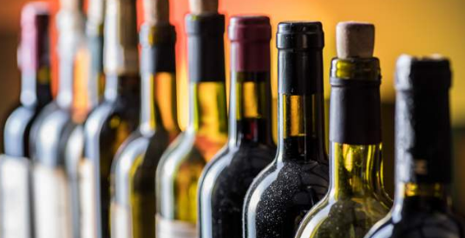
STANDARD OF FILL
The term “standard of fill” is used in the TTB regulations (Tax and Trade Bureau) to refer to the amount of liquid in the container.
Our current regulations prescribe certain specific standards of fill for wine and distilled spirits containers sold within the United States, such as 750, 500, 375, 100, and 50 milliliters.
The proposals are intended to eliminate unnecessary regulatory requirements and provide consumers broader purchasing options.

Slide 22
On July 1, 2019, the Alcohol and Tobacco Tax and Trade Bureau (TTB) published two eagerly anticipated notices of proposed rulemaking (NPRMs) to largely repeal the standards of fill for wine and distilled spirits containers. The highlights:
In the preamble to both NPRMs, TTB advances a number of significant policy beliefs on the topic of standards of fill, including:
Standards of fill are no longer needed to help protect the revenue and enforce the excise tax.
Standards of fill are not critical to protecting consumers, because consumers can rely on mandatory net content statements on labels.
The lack of any standards of fill for malt beverages has not created any revenue or consumer deception problems.

Slide 23
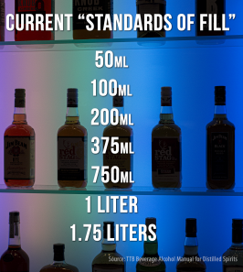
For spirits, TTB proposes to eliminate all standards except for a minimum of 50 milliliters and a maximum of 3.785 liters (one gallon). The maximum reflects the Federal Alcohol Administration Act’s statutory maximum for distilled spirit containers.
For wine, TTB proposes to eliminate all standards except for a minimum of 50 milliliters. TTB selected the 50-milliliter minimum to ensure that containers were sufficiently large to show all mandatory label information.
The distilled spirits NPRM also includes a proposal to codify in the malt beverage labeling regulations the longstanding practice of permitting metric volume measures in addition to the non-metric measures required by current regulations.

Slide 24
Both NPRMs (Notice of proposed Rule making) also discuss potential alternatives to eliminating the standards of fill by:
Maintaining existing standards but adding a number of new sizes to those authorized; or
Establishing a system where standards of fill are approved by TTB via a streamlined administrative process.
The comment periods for both NPRMs close on August 30, 2019.
These proposals respond to a number of petitions on the subject of standards of fill and appear to reflect the current Administration’s deregulatory agenda.

Slide 25
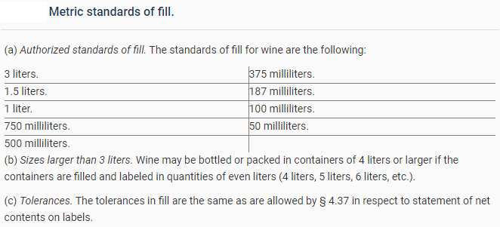

Slide 26
THANK YOU

